Slide 1


In Three Steps to Software Product Lines: a Practical Example from the Automotive Industry
Matthias Eggert, Karsten Günther
Rhine-Main-Team (RMT), Marquardt GmbH, Rietheim-Weilheim, Germany
Notes:
18-20 minutes
Motivation (5)
Complexity Reduction (3)
Modularization (3)
Versioned Dependency Management (3)
Conclusion (5)
Welcome to the talk about our paper: "In Three Steps to Software Product Lines: a Practical Example from the Automotive Industry".
My name is Karsten and that's my dear colleague and friend Matthias and we are members of the Rhine-Main-Team of the German automotive supplier Marquardt.

Slide 2
Agenda
Motivation
Goals
Initial Project Situation
Migration Strategy
Complexity Reduction
Modularization
Versioned Dependency Management
Conclusion
Notes:
So what are we going to talk about?
click
First we will talk about our motivation, the goals we had and still have.
We will briefly describe the initial project situation and circumstances, e.g., the tools and IT landscape we found when we started our journey.
click
After that we are going to present to you a possible migration strategy towards an SPL we developed for a real-world product family of an automotive Tier-1 supplier.
click
We will explain the three steps of our migration strategy: Complexity Reduction, Modularization and Versioned Dependency Management.
click
At the end we will present our conclusion, an overview on where we stand right now and giving a forecast on future work.
So, let's start with our motivation.

Slide 3
Motivation
Notes:
Roughly one year ago our team got the task to improve the tooling and methods in the SW development of a complex sensor cluster for electric cars.

Slide 4
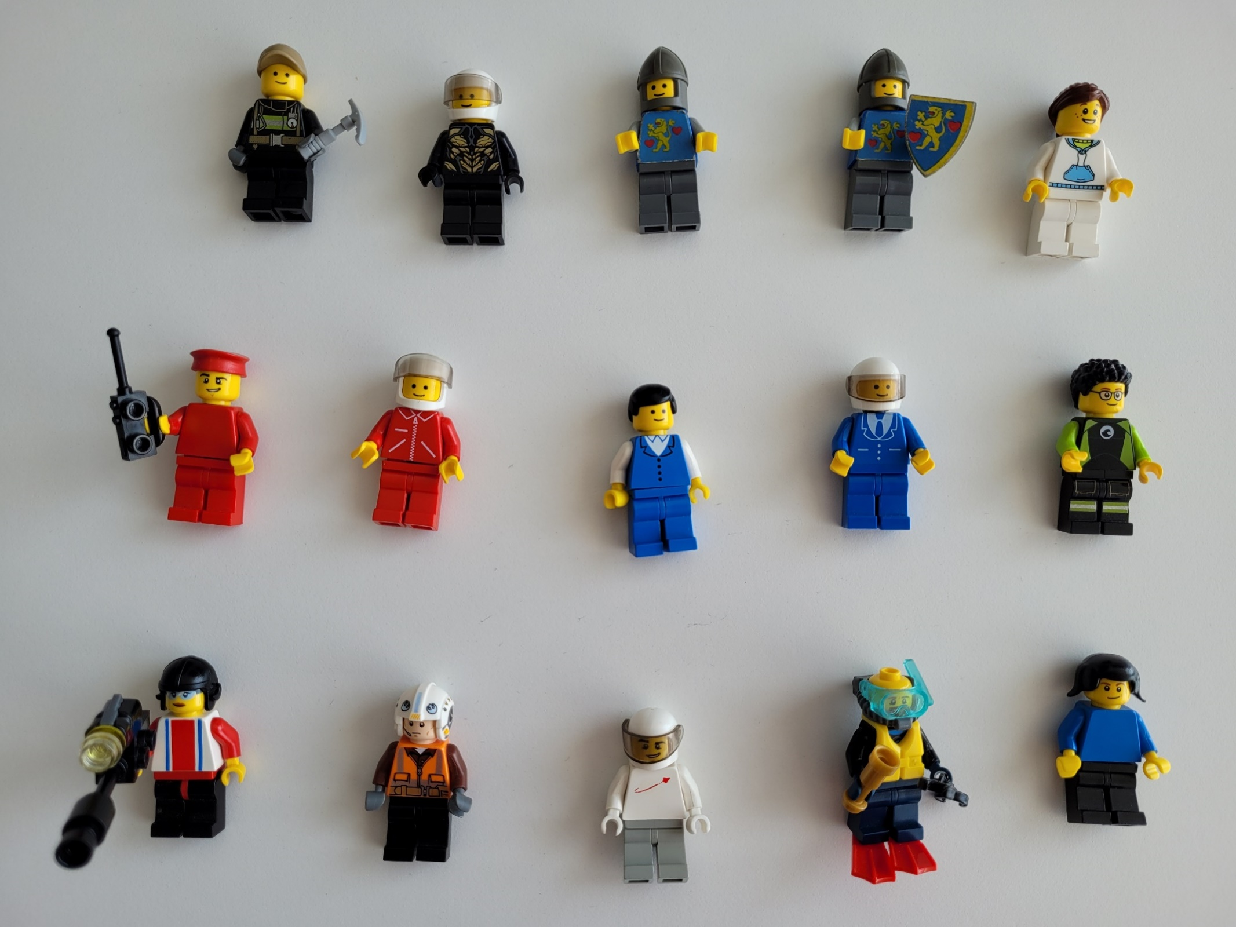
15 Sensor
SW projects
Notes:
Here we see 15 Lego figures representing 15 SW projects of our sensor cluster.
This product is developed for several different customers and model lines, therefore it is quite common in the automotive area to have one SW project or repository for one customer project like depicted here.
If a new customer project is acquired, a new SW project is created with the "clone-and-own" approach by simply copying an older project.

Slide 5
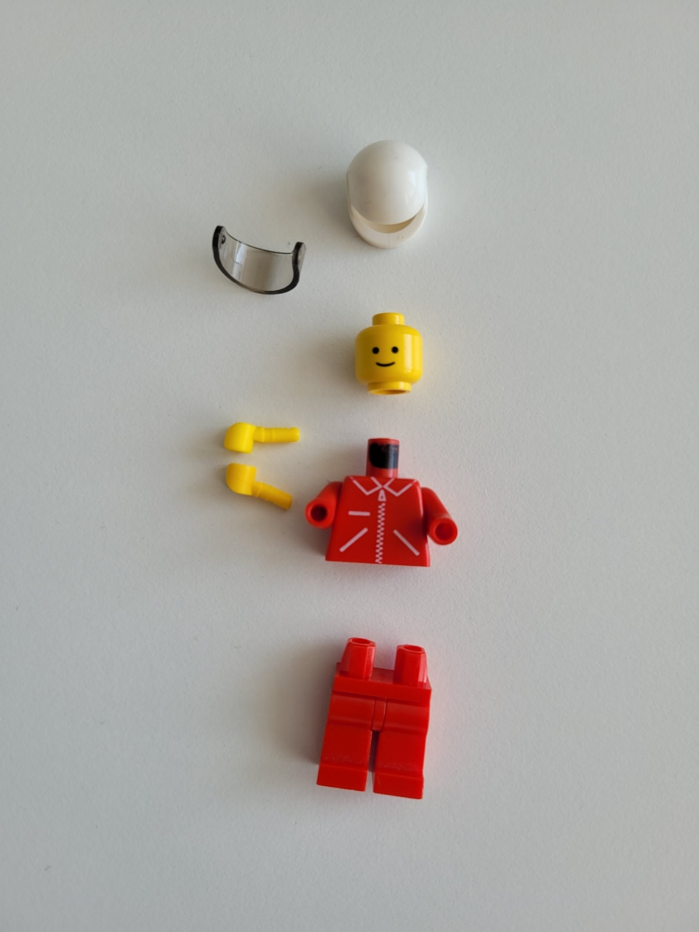
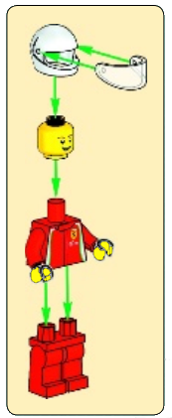

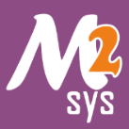
Voltage
Measurement
Current
Measurement
Build System
Notes:
If we have a closer look at one Lego figure representing exactly one SW project we see the different SW components, e.g., the head as voltage measurement or the hand as current measurement.
A single SW project also contains the build system including the build instruction, tools like GNU Make, MSYS2 and the cross compiler for the target microcontroller.
The advantage of this approach: you don't start on the greenfield and have a short setup time.
But there are also many disadvantages ...

Slide 6
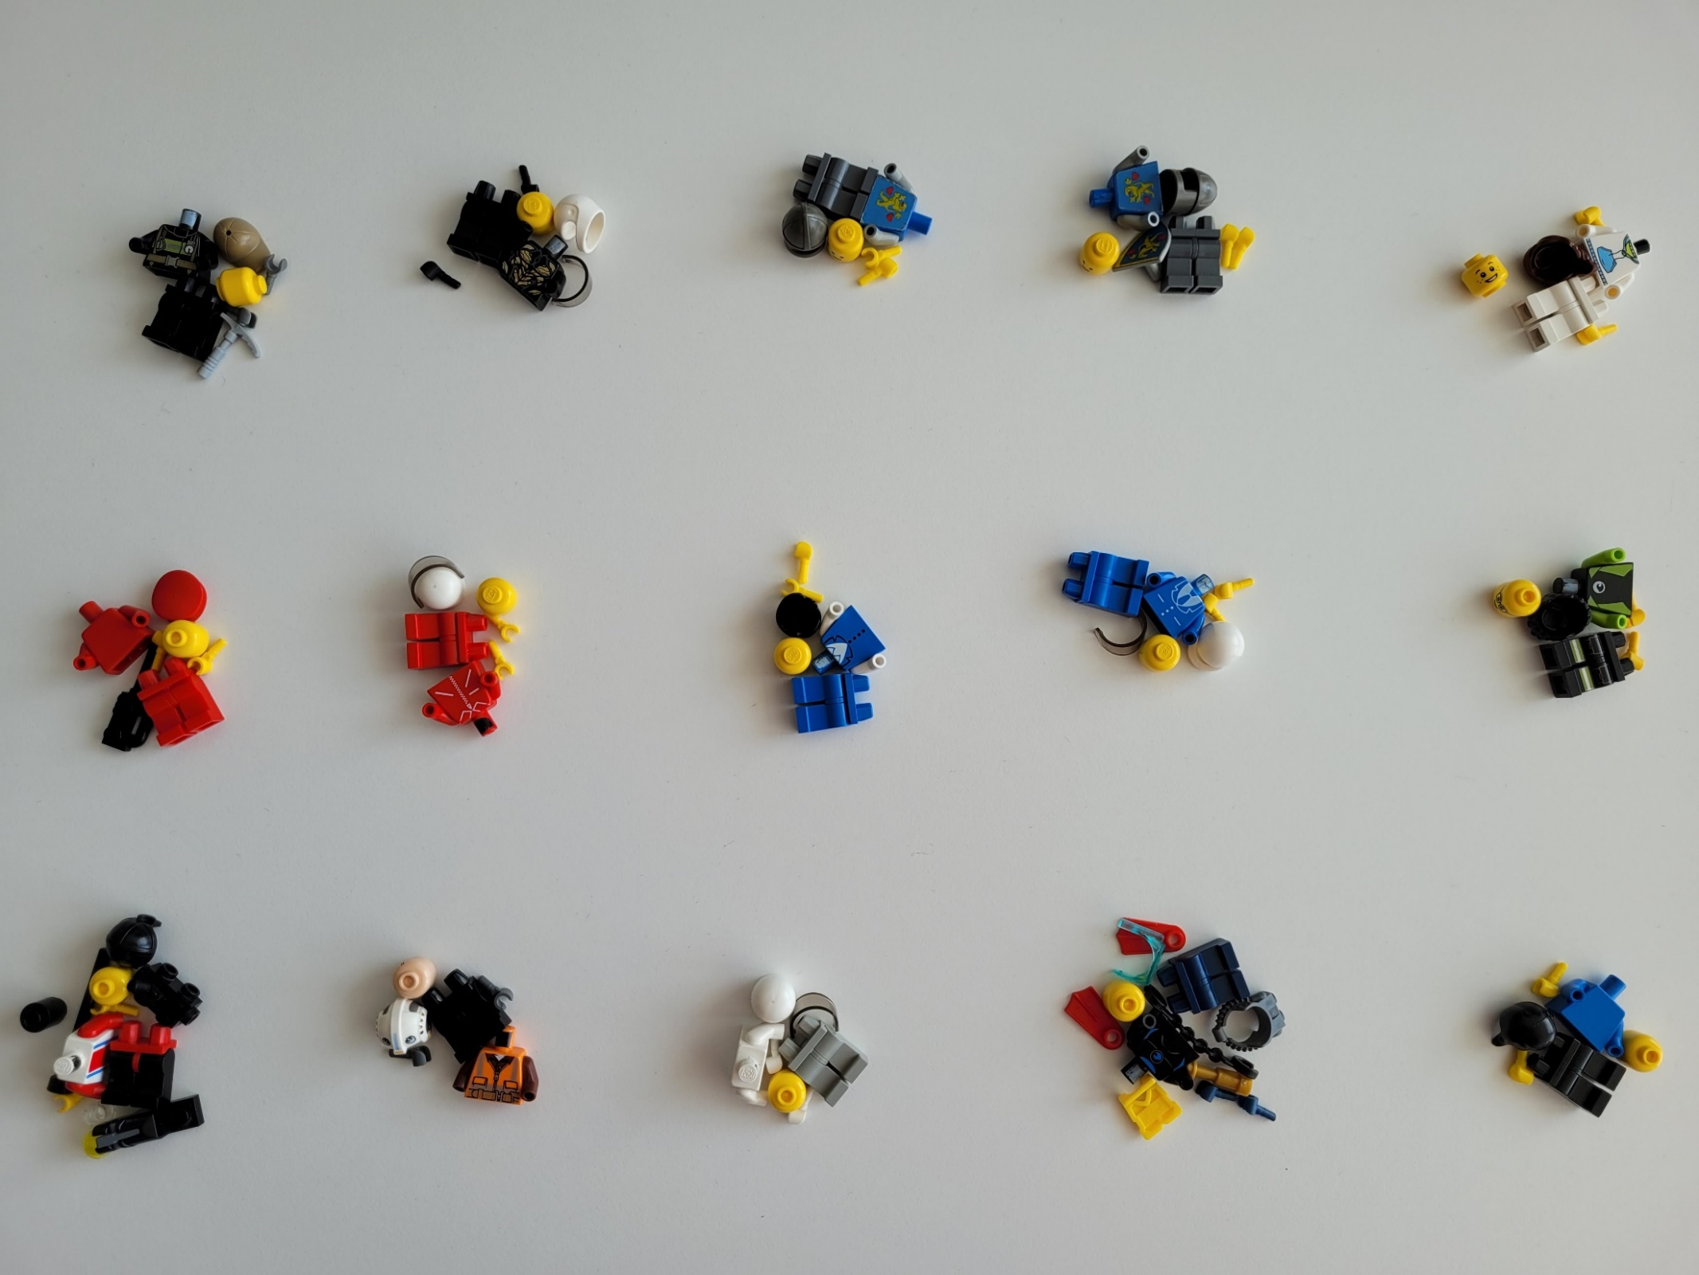
Current
Measurement
Voltage
Measurement
Voltage
Measurement
Voltage
Measurement
Current
Measurement
109 SW components
Voltage
Measurement
Notes:
If we look at all SW projects again we can now see 109 SW components in total plus the 15 build systems.
We can immediately identify duplicated or similar SW components that could be reused.
But …

Slide 7
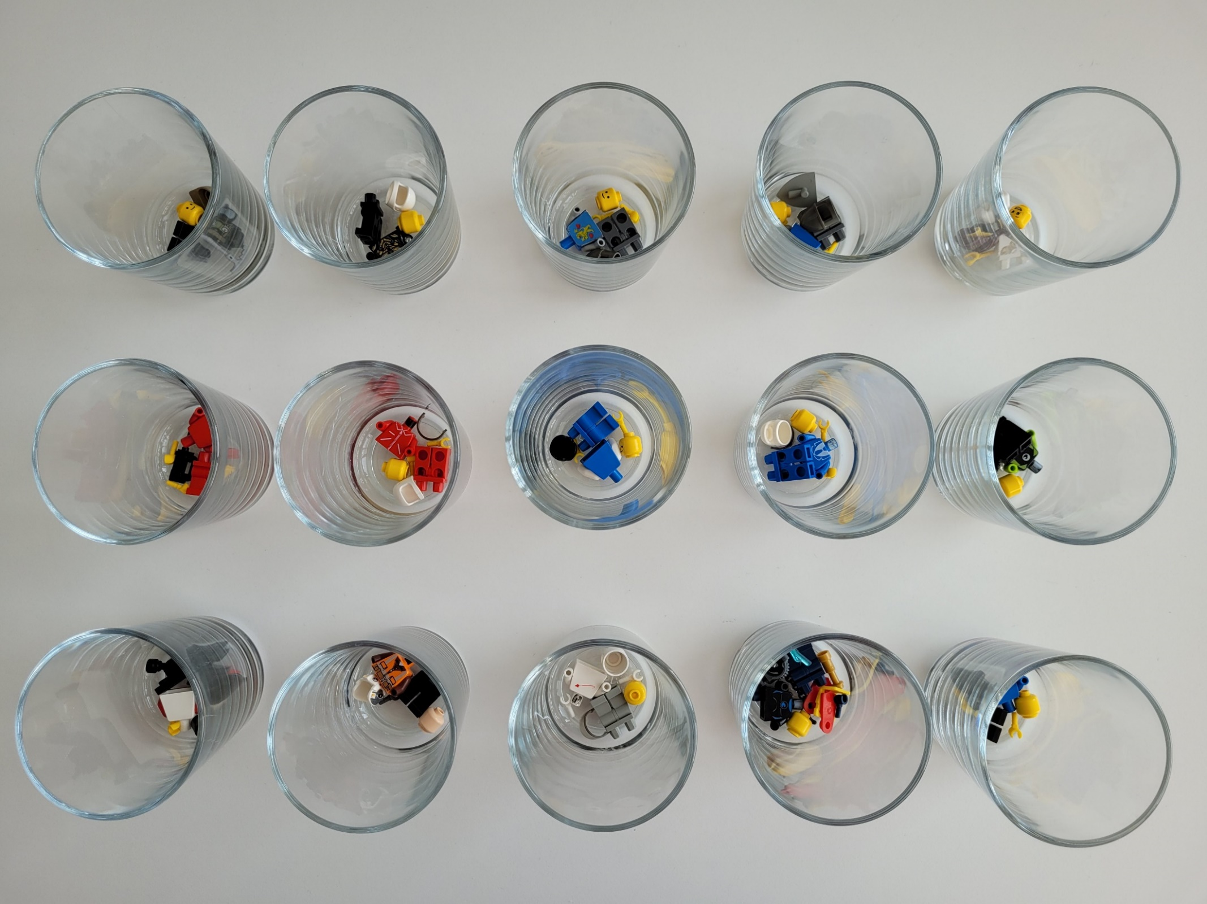

15 repositories
15 build systems
109 SW
components
Notes:
… with the current source code management system there is no reuse possible between the depicted glasses.
Each glass is now an independent source code repository.
The SW projects at Marquardt are mainly managed as repositories in the SCM system "Dimensions CM" from the company Micro Focus.
When we started it was the same situation with the complex sensor cluster.
Component developers had to make their component changes in several different Dimensions repositories.
Here we can see the disadvantages very quickly:
We see a waste of men power here due to the high maintenance effort of components in different repositories.
There is also a high possibility of SW erosion, i.e., former identical source files diverge from each other due to different customer specific implementations.
Improvements cannot be shared and refactoring becomes almost impossible.
So how to tackle these disadvantages and make our developer life easier?
The answer: the migration to a Software Product Line would allow reuse and sharing of core assets and features of SW components.
But how should a migration strategy look like for real-life projects already started with a tight release plan?
Our answer is an iterative and incremental migration strategy consisting of three consecutive steps.

Slide 8
Complexity Reduction
Repeat step:
incrementally
Go on with next step:
iteratively
Modularization
Versioned Dependency Management
time
Notes:
Our first migration step "Complexity Reduction" is only a preparation step that brings duplicated or similar code together within an SPL-capable build system.
click
Complexity Reduction can be repeated incrementally for each project being migrated to an SPL variant.
click
The second iterative migration step "Modularization" builds up configurable sources.
Every component gets its own space. In an SPL we talk about variation dimensions: space is one of them.
click
The third step is a step towards variation in time.
Components get out-sourced and can be integrated in any version.
Each of those three migration steps can be repeated for each project, variant and component seperately.
We wanted to avoid a kind of big bang migration due to our experiences with the projects of our former employer.
Our last big bang migration to GitHub took us more than a year of preparation without any visible improvement before flipping the switch after a weekend’s work.
So let's have a look at the first migration step ...

Slide 9
Complexity Reduction
SPL repository
.vscode/
cmake-kits.json
cmake-variants.json
settings.json
legacy/
variant-a/
component-1/
component-2/
variant-b/
component-1/
test/
test_build.py
test_unittests.py
variants/
variant-a/
config.cmake
parts.cmake
variant-b/
config.cmake
parts.cmake
CMakeLists.txt
Jenkinsfile
Project A
src/
component-1/
component-2/
config.mak
Makefile
parts.mak
tools.mak
Project B
src/
component-1/
config.mak
Makefile
parts.mak
tools.mak
Notes:
Complexity Reduction.
The goal of this step is to bring all projects into one repository and to enable a mindset change from project to product development.
It consists of 4 parts.
Click
First we copy the sources of several projects as legacy sources of variants without any changes or adaptions.
Click
Second we create CMake variant configuration files out of the existing GNU Make files.
Click
Third we create IDE configuration for seamless integration in Visual Studio Code as build settings for each variant.
Click
And last but not least we establish Continuous Integration by creating a Jenkinsfile and test cases for the target build and unit test execution.
Click
We call this step Complexity Reduction because of the decrease of used systems: one repository per product instead of many, one shared CMake build system and tool environment instead of several independent Makefiles and scripts.

Slide 10

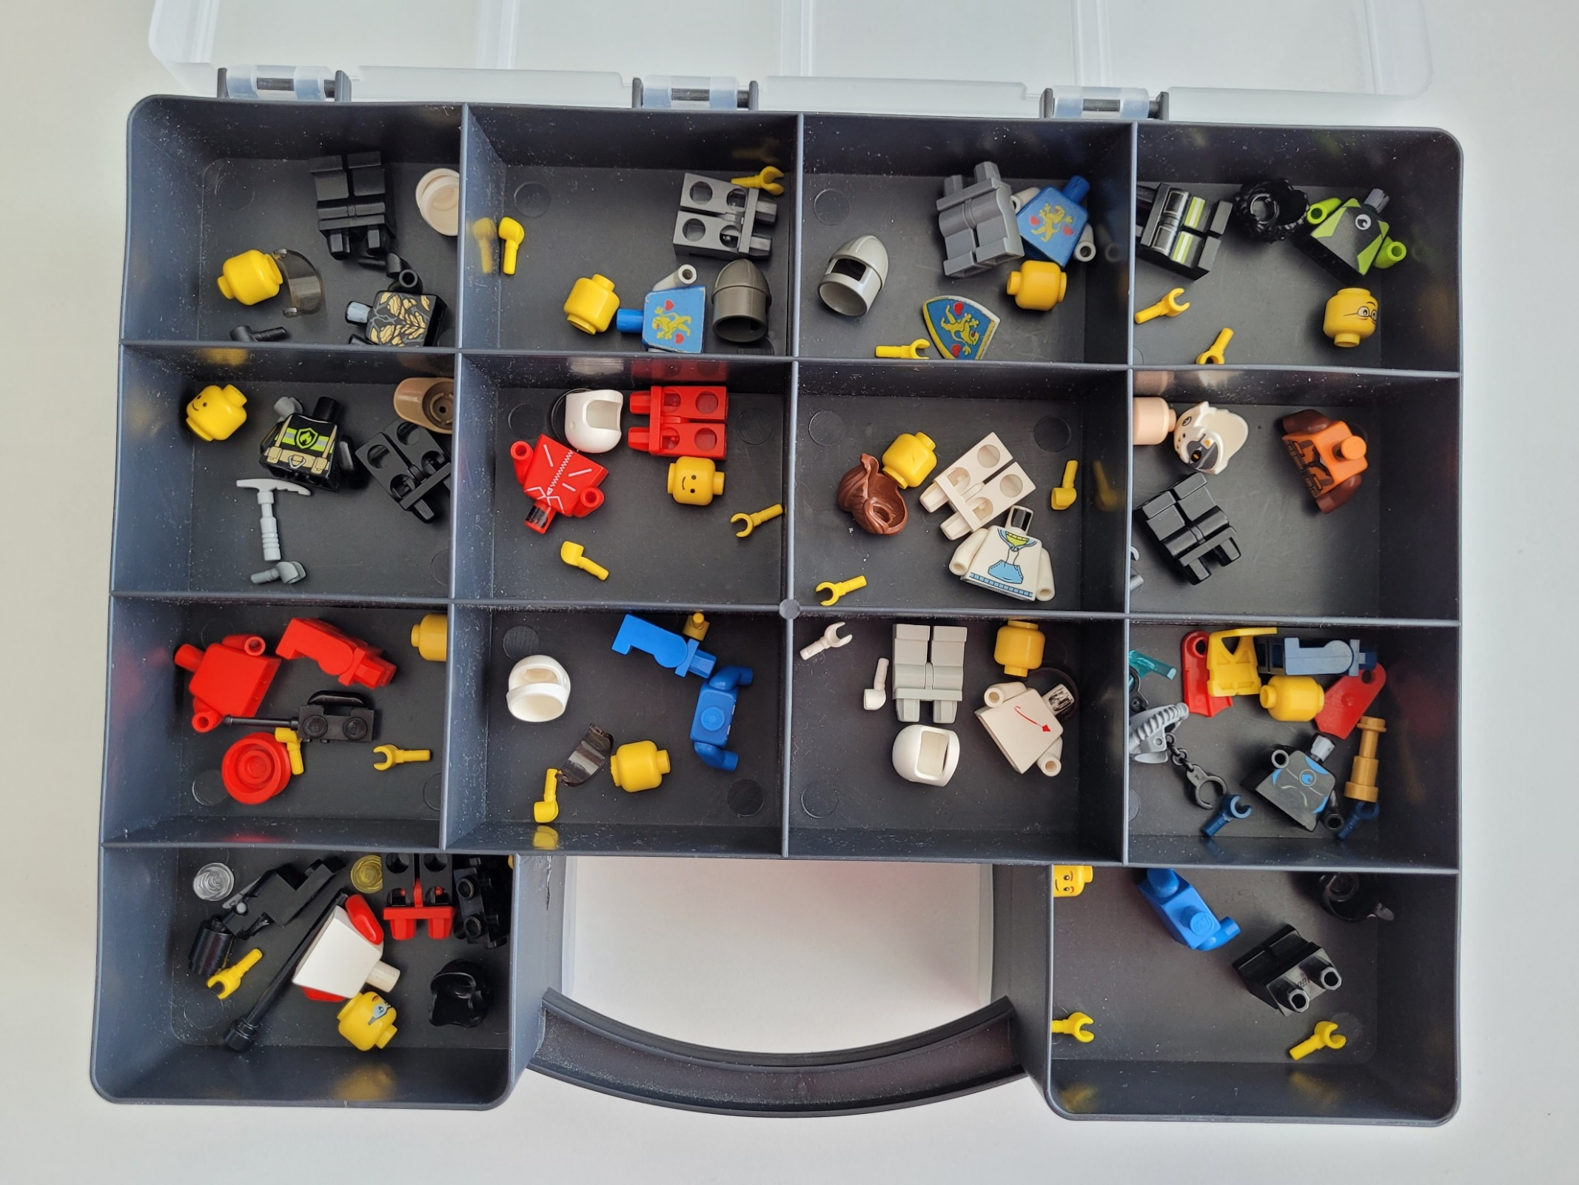

SPL
legacy
legacy
legacy
1 repository
1 build system
109 SW
components
Notes:
The box shown here represents the Software Product Line repository of the sensor cluster product.
It is a Git repository on a BitBucket server with each compartment of the box holding a legacy source code folder and a variant configuration of one single variant.
The complexity reduction is visible as well: I have everything in one single box that is easy to carry compared to 15 glasses.
Nevertheless this step has a high impact on the workflow for SW developers already.
At the same time we introduce a new SCM system, a new build system and a new Continuous Integration environment.
The execution of this step for one project can be planned and done independently of the others and with the project‘s pace and time schedule.
Now I will hand over to Matthias explaining you the consecutive steps in details. Matthias: your stage ...

Slide 11
Modularization
SPL repository
SPL repository
SPL repository
.vscode/
legacy/
variant-a/
component-1/
component-2/
variant-b/
component-1/
test/
variants/
variant-a/
config.cmake
parts.cmake
variant-b/
config.cmake
parts.cmake
CMakeLists.txt
Jenkinsfile
.vscode/
src/
component-1/
variant-a/
variant-b/
component-2/
variant-a/
test/
variants/
variant-a/
config.cmake
parts.cmake
variant-b/
config.cmake
parts.cmake
CMakeLists.txt
Jenkinsfile
.vscode/
src/
component-1/
variant-x/
component-2/
variant-y/
test/
variants/
variant-a/
config.cmake
parts.cmake
variant-b/
config.cmake
parts.cmake
CMakeLists.txt
Jenkinsfile
Notes:
The next step is Modularization, in other words we propose switching from a project to a product structure by identifying standard SW components and their variants.
We defined 3 stages as part of this step.
Click
First we migrate from legacy components to product components without any source code change.
Rather than having variants holding all their components, it is now components taking care of their variants.
Each variant of a SW component is still project specific, but SW component variants are now in the same folder.
Each component can be moved to the product structure incrementally, component by component.
Click
In the next stage we remove duplicates.
Two components are considered duplicates if their contents are identical.
Like this we introduce a big advantage of SPLs: reuse, and with this a reduction of components.
This shall reduce workload and the risk of accidentally producing new variants.
The final stage of Modularization is making components configurable by identifying core assets and variant specific functionalities.
Therefore we changed the variant names to reflect configurable SW components that are not project specific anymore.
This step is still focusing on the space dimension of SPLs.
Remember: SPLs have at least 2 dimensions, one for space and one for time.

Slide 12
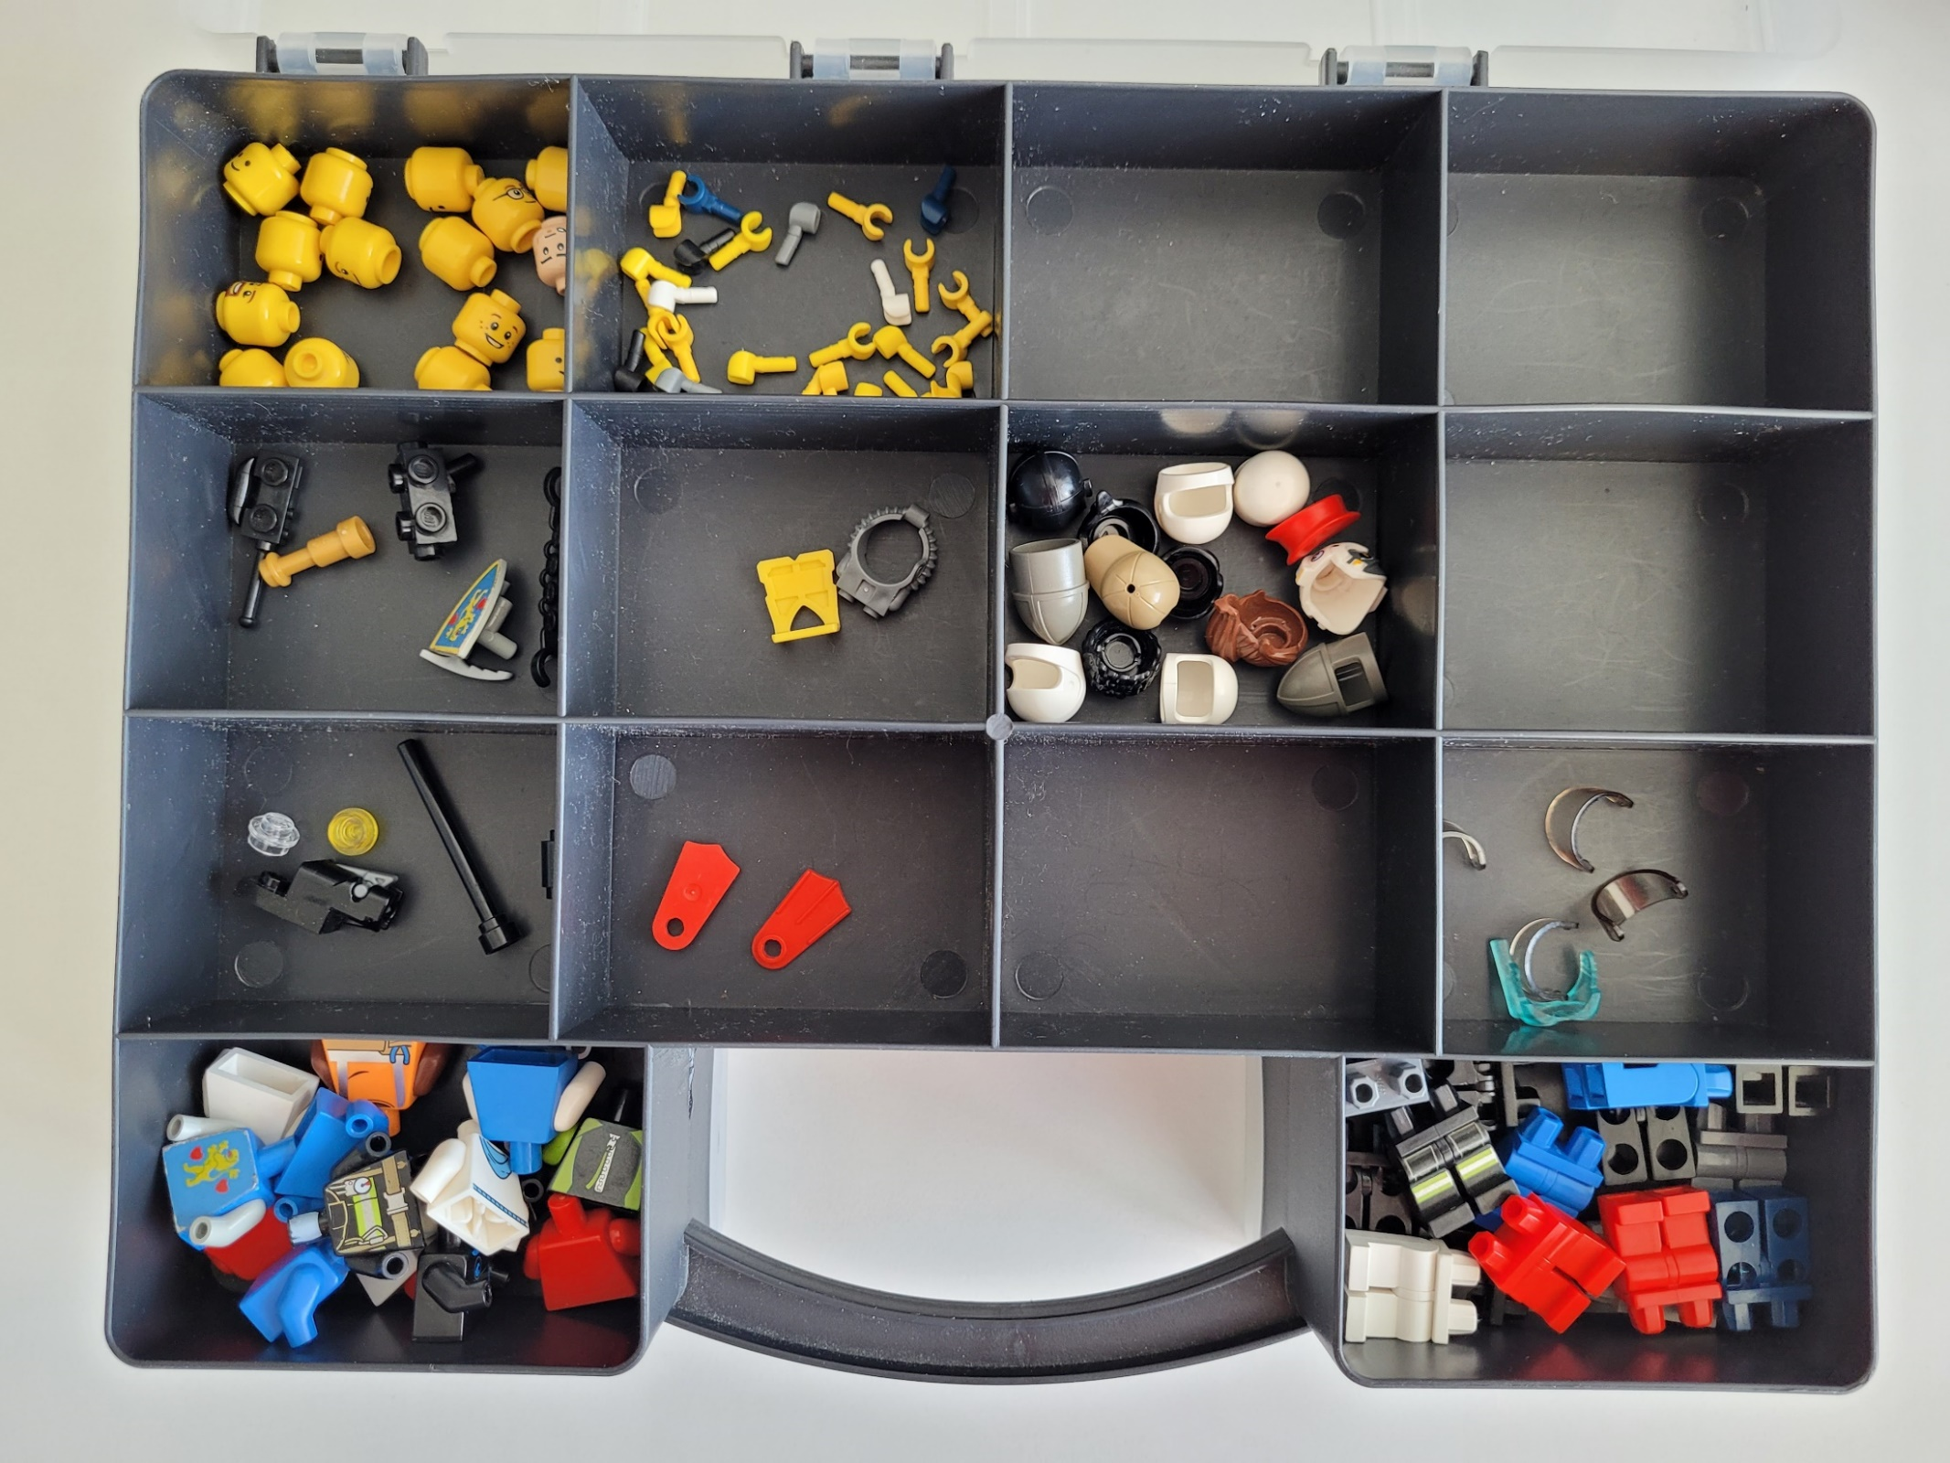
Voltage
Measurement
variants
Current
Measurement
variants
1 repository
1 build system
109 SW
components
Notes:
In our Lego example each compartment of the box is now a folder holding the different variants of a SW component.
Like this it becomes easier to compare and identify the number of variants per component and it makes further steps easier as well.

Slide 13
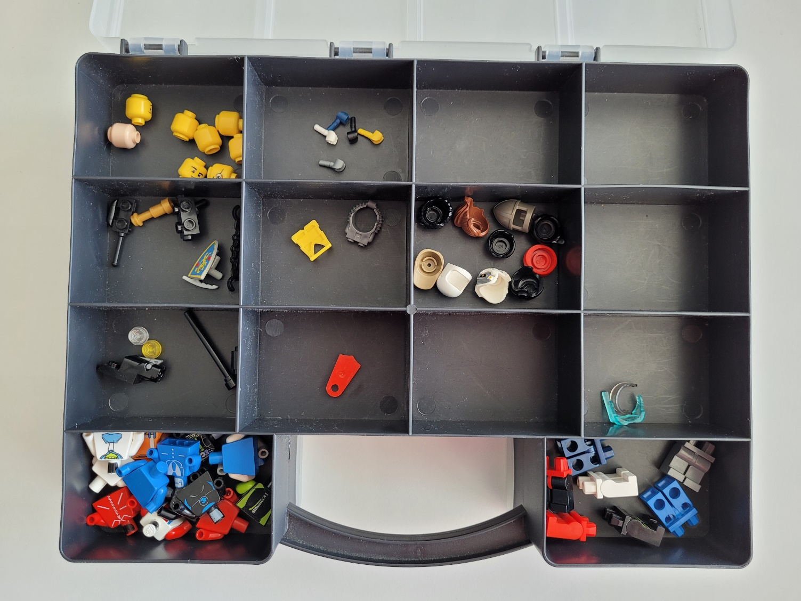
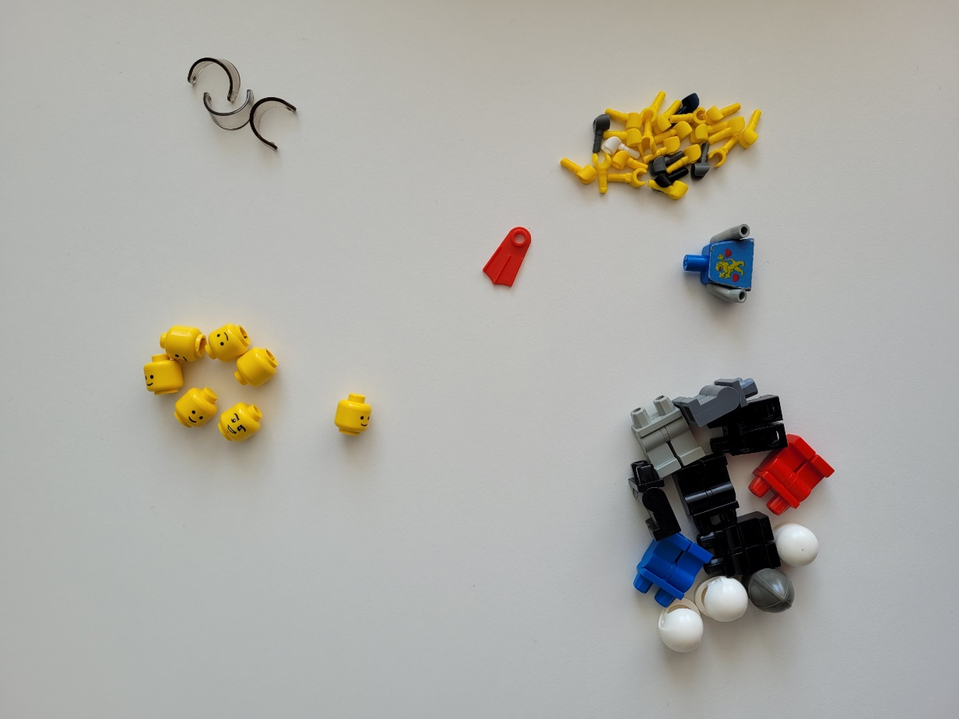
50 parts
1 repository
1 build system
59 SW
components
Notes:
After switching the structure we are able to identify and remove duplicate parts.
On the right side we see the discarded Lego pieces.
With this stage we were able to reduce the number of SW components from 109 to 59.

Slide 14
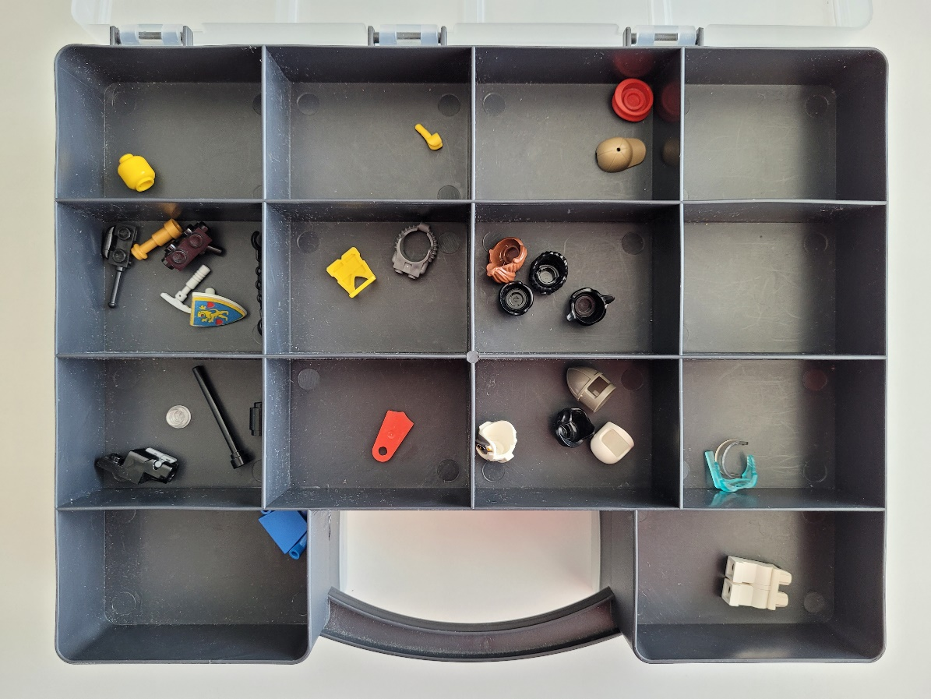
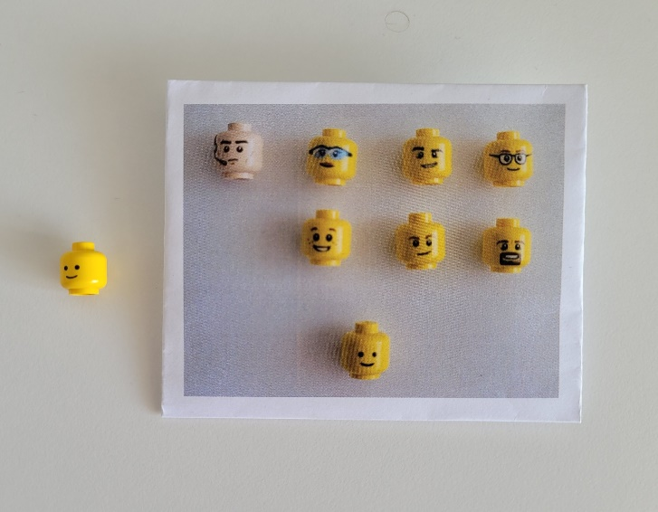
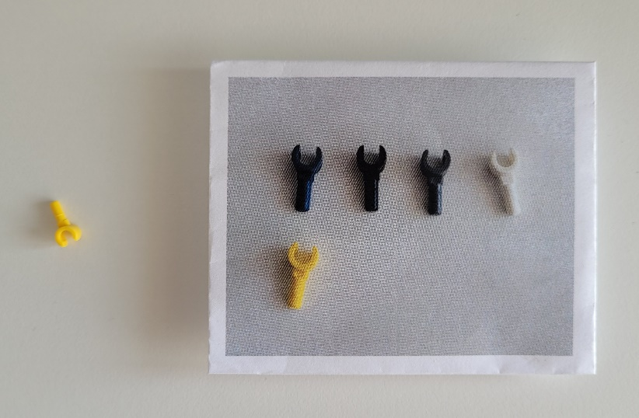
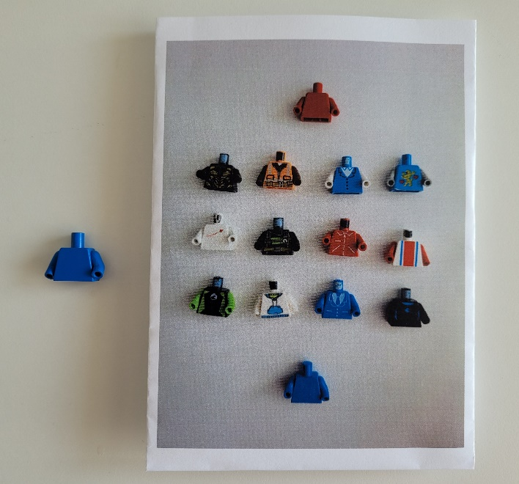
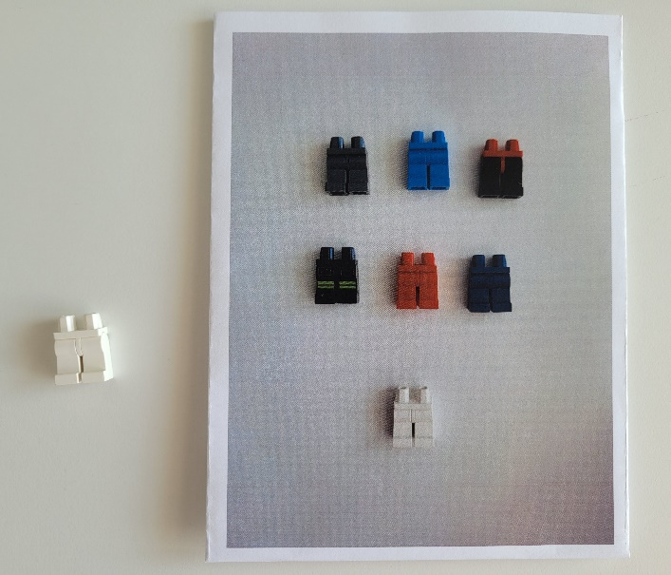
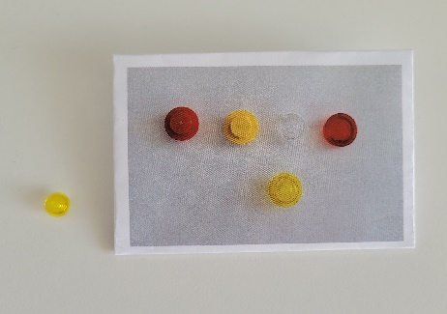
Configurable Sources
Voltage Measurement
Configurations
Current Measurement
Configurations
1 repository
1 build system
29 SW
components
Notes:
The final stage of Modularization is making components configurable by identifying core assets (which is represented by the shape of the Lego brick) and decorators (color and print).
The advantages we gain with this are that different projects are able to use the same software component.
Also a change in a core asset must be done only once and is available in all variants immediately, reducing maintenance an development efforts.
This final stage reduced the number of SW components from 59 to 29.

Slide 15
Versioned Dependency Management
Notes:
While the other steps focused on the variation in space, the versioned dependency management focusses on the variation in time.
Git already has a possibility of variation in time.
The commits and branches are theoretically useable as baselines.
The practical problem here is that a commit is always a snapshot of the entire repository.
It is not possible to create different baselines nor different versions of individual components, only versions of the entire repository.
Furthermore if you have to apply a fix on one release branch, it might be required to apply this fix to many other branches as well.
This can prevent us from maximizing reuse and can actually increase the amount of code changes, because commits and branches are independent of each other.
This is why we propose a new structure as third step for versioned dependency management.

Slide 16
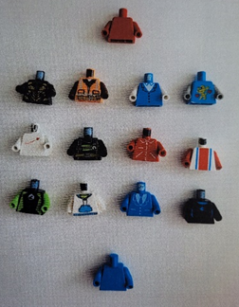
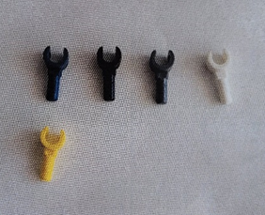
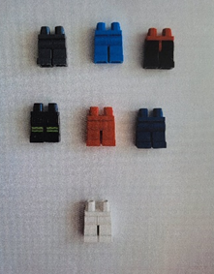
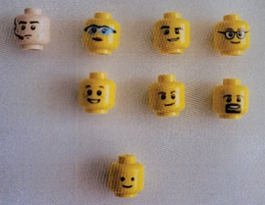
SPL
Notes:
For this new structure it is required to split up the repository again.
But this time not per project anymore, but one repository per component.
What is left in the original SPL repository is a description of what and how to integrate, basically a list of references to components and a product-specific build system.
This final step can again be done incrementally, component by component.
The benefits we see with this approach are:
independent component releases and thus faster release loops,
reuse across the time dimension of our SPL,
and component releases can be centrally marked as faulty in the components repository and if required print warnings during the build where they are used.
We also see a cross-product component reuse on a higher level: e.g. current or voltage measurement could be used in a wide range of electronic products.

Slide 17
Conclusion
Notes:
To sum everything up again …
We proposed three steps for our migration strategy: complexity reduction, modularization and versioned dependency management.

Slide 18
<Build
System>
<Configurable
Sources>
<Configuration
Data>
<Legacy
Sources>
Number of Lines Of Code = # LOC
Step: 1 * 2 * * 3
time
# features
Legend of migration steps:
Import for Complexity Reduction
Modularization using configurable sources
Isolation for Versioned Dependency Management
(*) Adaptation and further development
Content
of isolated
component A
# LOC
Content
of isolated
component B
# LOC
Notes:
The content of the SPL repository, especially the number of lines of code, changed during the different migration steps as shown.
In the first migration step Complexity Reduction the lines of code increased with every legacy project being added to the codebase.
During Modularization legacy sources were exchanged with configurable sources, which lead to a reduction of duplicated files and therefore to a decreased amount of code.
Finally, even the lines of code of configurable sources in the SPL repository decreased, as the sources were isolated and moved to separate repositories during the third step Versioned Dependency Management.

Slide 19
Migration strategy
Delayed by
Unit Tests
Automation
Social obstacles
We will repeat the
migration for other
products as well.
Notes:
We presented an incremental and iterative migration strategy towards SPL for software of a real world product family of a tier one automotive supplier; even though we used Lego figures to better visualize it.
We were able to partially apply our migration strategy by performing every step incrementally and continuing iteratively with the next step.
We achieved a stable SPL with all variants being buildable at any time,
reduced workload of developers by simplifying their environment,
increased collaboration across project borders
and were able to integrate all parts of the software of our product family into the same space.
Until now we have moved 10 variants of our sensor cluster, each got automatically imported.
And we have a build system available that fully supports variant handling.
Step 2, Modularization, is prepared from build system perspective, but was only partially done and needs to be finished soon.
We had a higher focus on strengthening unit tests and automation of artifacts creation, before we wanted to start with refactoring to finish building up configurable sources.
Besides all the discussed technical challenges, there were also social obstacles on the way to introduce an SPL.
Fear of change was probably the strongest emotion we faced.
We feared the introduction of our SPL approach, although we were certain that all required build system features were implemented and we knew it was always easy to go back to the old system.
We could simply copy the sources back.
Afterwards we do not see a reason for hesitation, but sometimes it simply needs someone brave in the team or someone pushing you.
Our conclusion is: Just do it! And if you break it, make sure you can fix it fast!
We are now confident enough about our migration strategy and plan to repeat the same migration for other product families at Marquardt.

Slide 20

The end, but there is more …

Slide 21
Backup

Slide 22



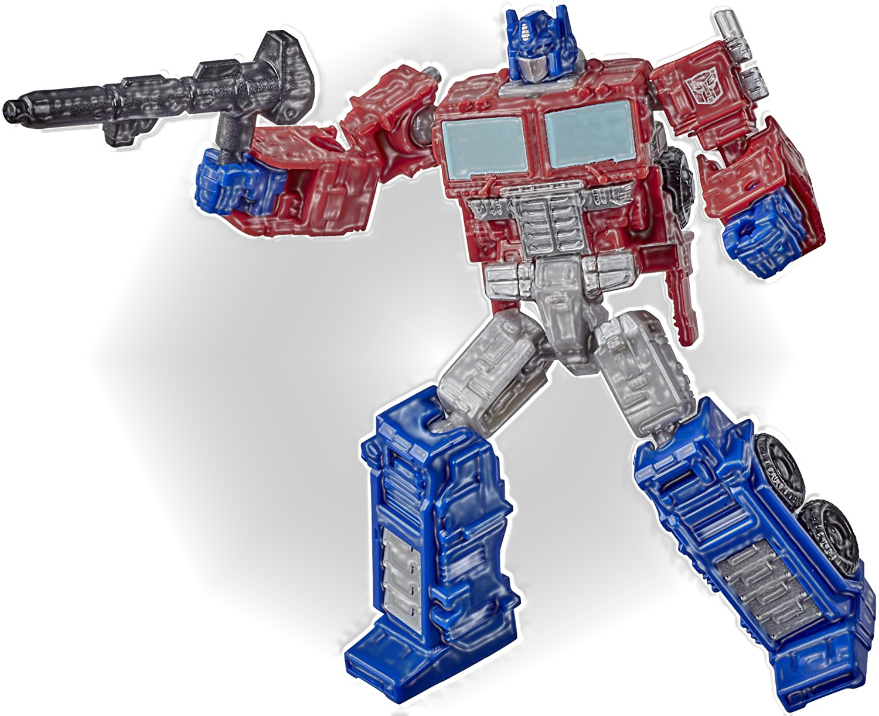





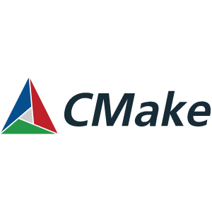


Transformer
Notes:
MQ is a tier 1 supplier
Development of product families
Complex Sensor Cluster
Past situation:
Customer projects become sw projects 1:1
Often customer centers get established
Task force per customer all at the same time
Same at other companies (our old employers)
Did a transition already in the past and wanted to learn from it (big bang vs. Iterative/incremental; 6 persons; one year preparation)
we plan to repeat the same transition for other product families @MQ
Component responsibles had to make their „component changes“ for 10 customer projects in 10 different Dimensions repositories
„Waste of men power“
SW erosion
High effort for refactoring in shared parts
High maintenance effort, late errors
Clone-and-own
Short setup time
Usually copied a functioning repo → adaption comparable fast
All dependencies inside the repository itself (self contained ready to build)
Our goal:
Reduction of development costs
Reuse of SW code/components
Component development for one product family in one repository
meet tight release plans with active projects in the projects‘ own pace
Adaptions for specific customers
Get rid of legacy build system == Gnu Make and introduce modern IDE; RCS vs Git; nightly builds vs CI, Unit test as integral part
Variant capability to build system
Tools outside of repository
IT strategy to change systems but no plan on how to do the transition (eg Dimension to Git and Jira)
Iterative and incremental

